Slide 1

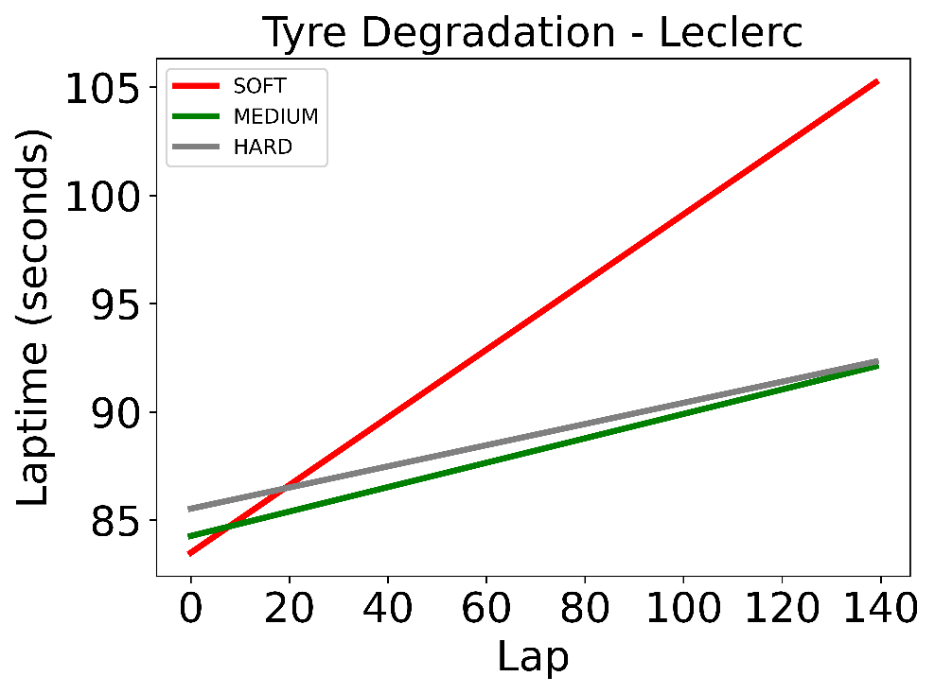
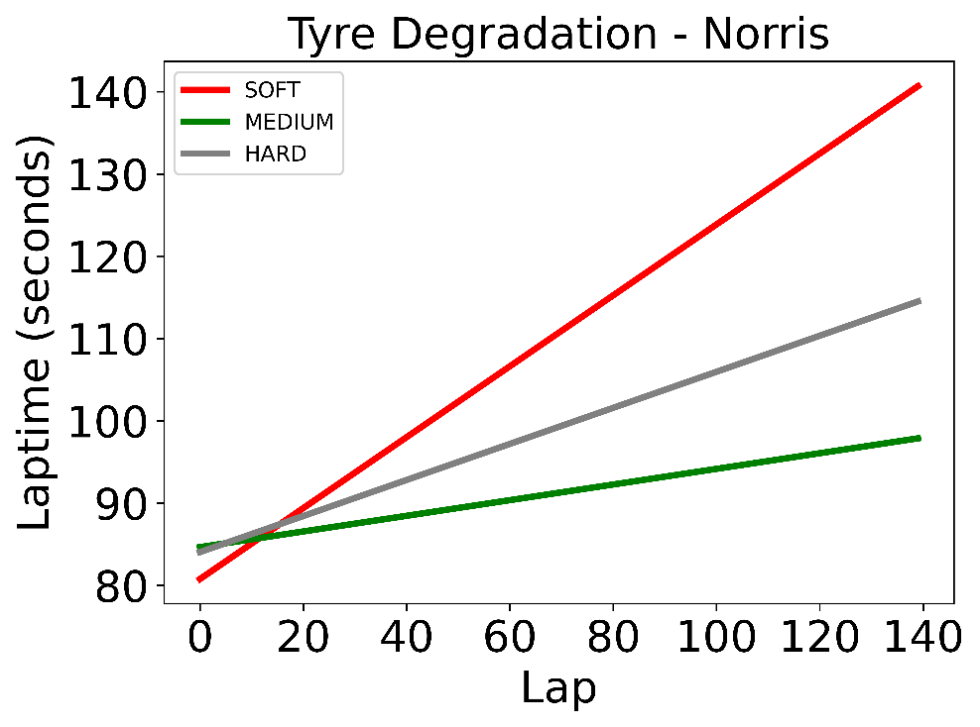
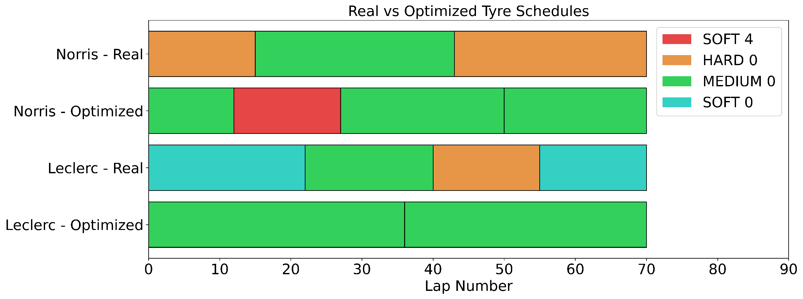
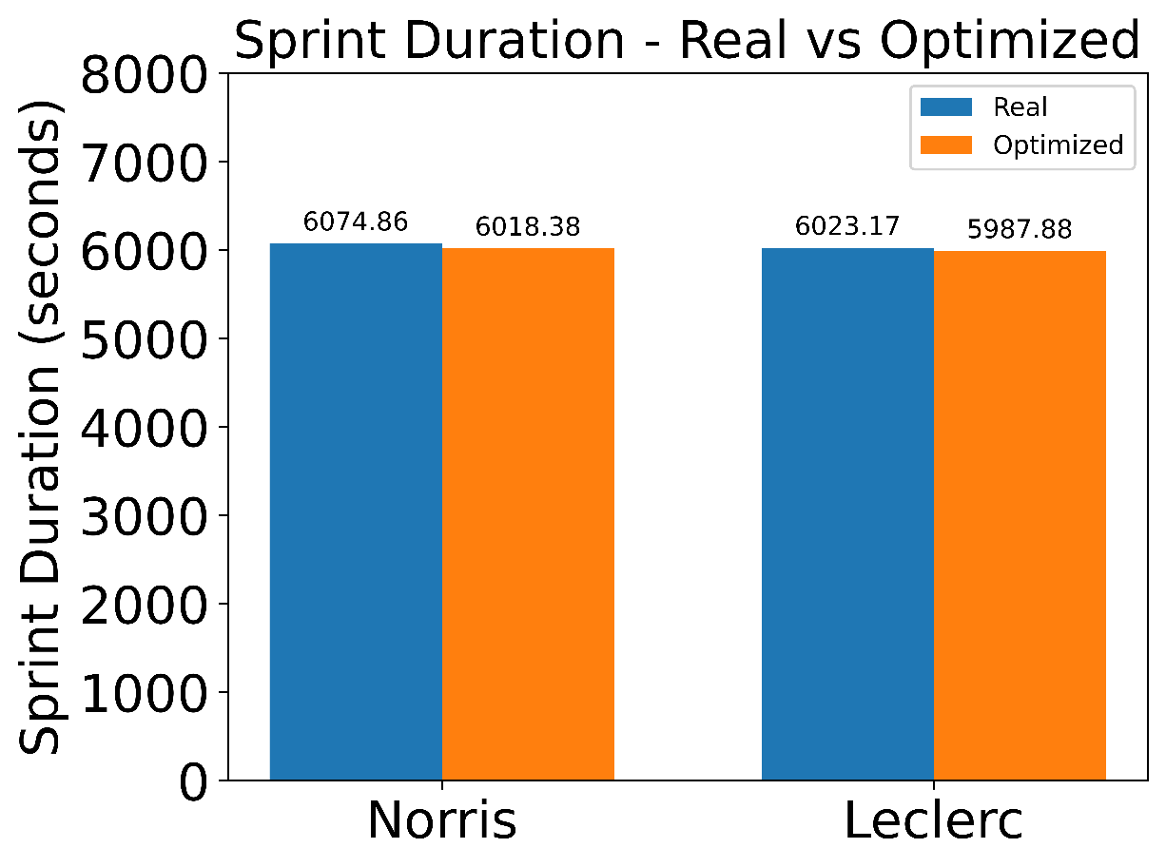
Optimization of Tyre Selection and Pit Stop Strategies
Christopher Quinn (CCSE)
Demetrios Kriezis (EECS)
Executive summary
What are the data?
What is the impact?
The goal of this project is to schedule the optimal pit stop strategy and tyre choice for a Formula One racing session.
We formulated and implemented a binary optimization problem that minimizes the duration time of a Formula One racing session.
We tested it for two drivers in the 2022 Hungary, Budapest and found that an optimal schedule will shorten their race duration.
Planning - pit stop teams can coordinate with race car drivers to determine a pit stop and tyre selection strategy ahead of time.
Real-time strategy adaptation – teams can use the optimization model during a race and change strategy as new data or conditions arise. Example: weather affects the lap times of tyres and rain could influence the data.
The strategy obtained by optimization can improve a team’s score and dramatically change the race.
Problem statement
Laptimes per tyre type were extracted from real race data using linear regression
The pit stop time is an average pit stop time
Objective: Minimize the race duration for one isolated driver
Decisions:
Choice to pit stop for Δt seconds after every lap
Choice of tyre compound
Constraints:
13 tyre sets available
Some tyres might be partially used
Data:
Laptime per lap per tyre choice
Pit stop duration
What are the key findings?
If you had another week, what would you do?
Incorporate robust optimization modeling to introduce uncertainties in the data. Uncertainties can come from:
Weather conditions.
Crashes from other drivers and road obstructions.
Other
OR
Introduce non-linearity into data from the weight of the vehicle getting lighter due to fuel consumption, which depends on the previous tyre choices since the fuel consumption depends on the elapsed time.
Why do we care?
Tyre choice can shave seconds from a driver’s total time.
If both drivers had used the optimal tyre choice, they could have improved their sprint duration.
In a Formula One race every tenth of second counts
Find the optimal spot during tyre degradation to pit
Save time
Win races and prize money
Attract sponsorships
Simply enumerating choices is too slow – billions of choices to evaluate! Optimization model solves in seconds. Allows for real-time use of the model.
Norris can improve by 56 seconds.
Leclerc can improve by 36 seconds.
Optimal strategy predicted resembles strategy of race winner
15.071—The Analytics Edge Fall 2019
15.093—Optimization Fall 2022

